Slide 1

Project Report
Optimal Control Design for an Inverted Pendulum on Cart
NGUYEN DUC GIAP - 2022324052
2023.12.12

Slide 2
1. System Modeling
이 곳에 네번째 소제목을 적어주세요
System description, nonlinear dynamics, linearization, discretization.
CONTENTS
2. Control Design
이 곳에 네번째 소제목을 적어주세요
LQR-integral, LQR-velocity, LQMPC.
3. Conclusions
이 곳에 네번째 소제목을 적어주세요

Slide 3
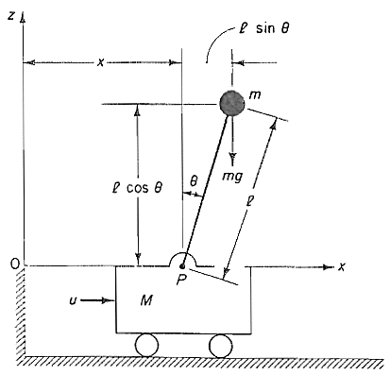

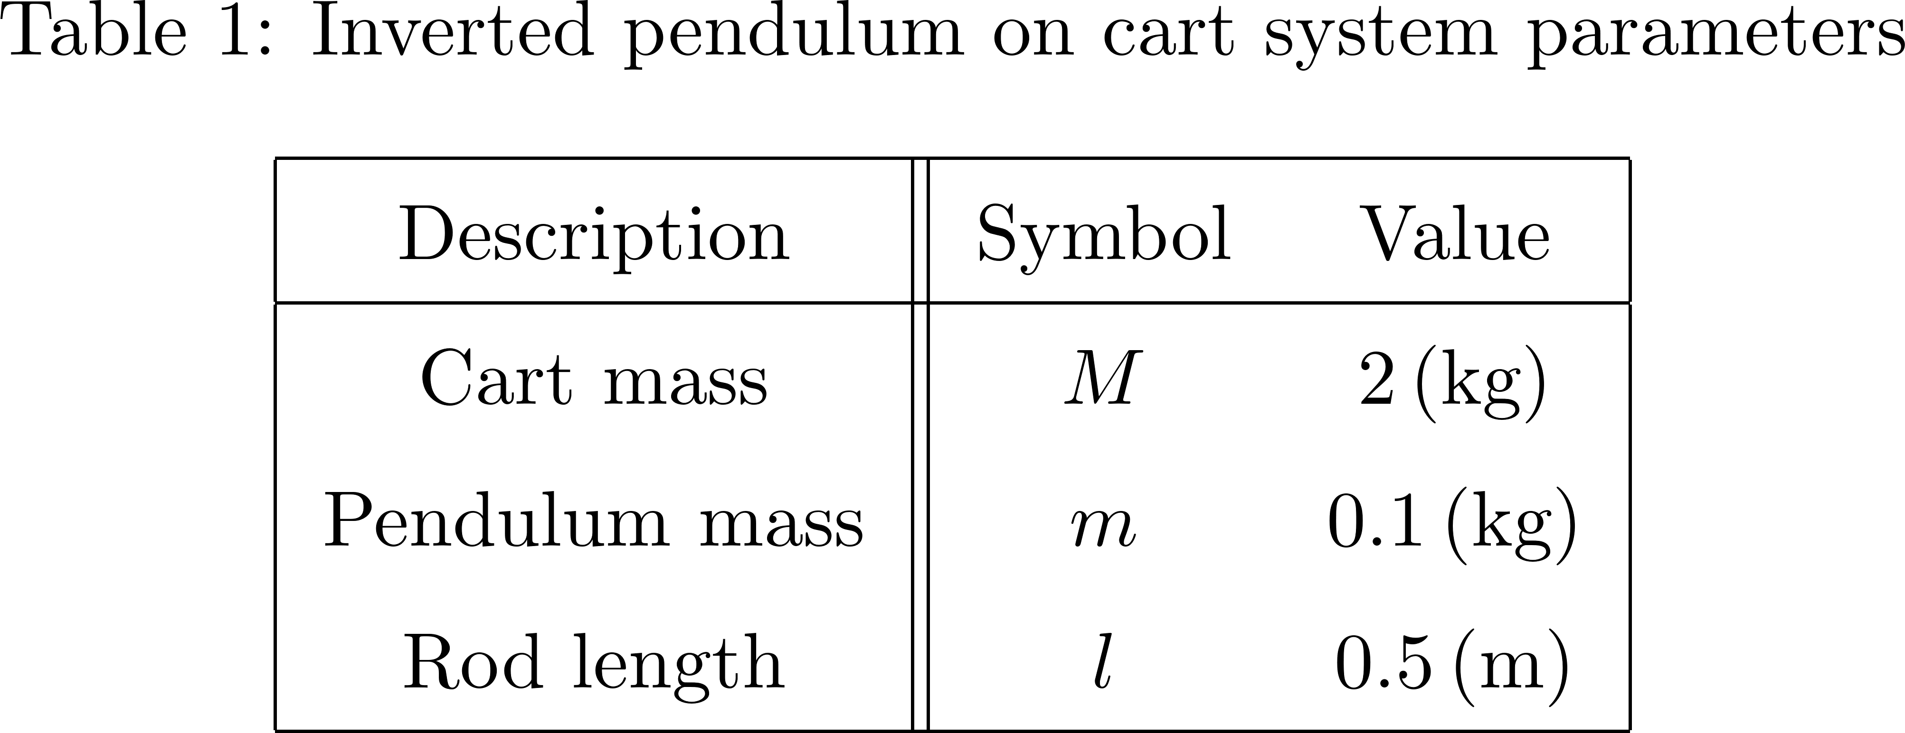
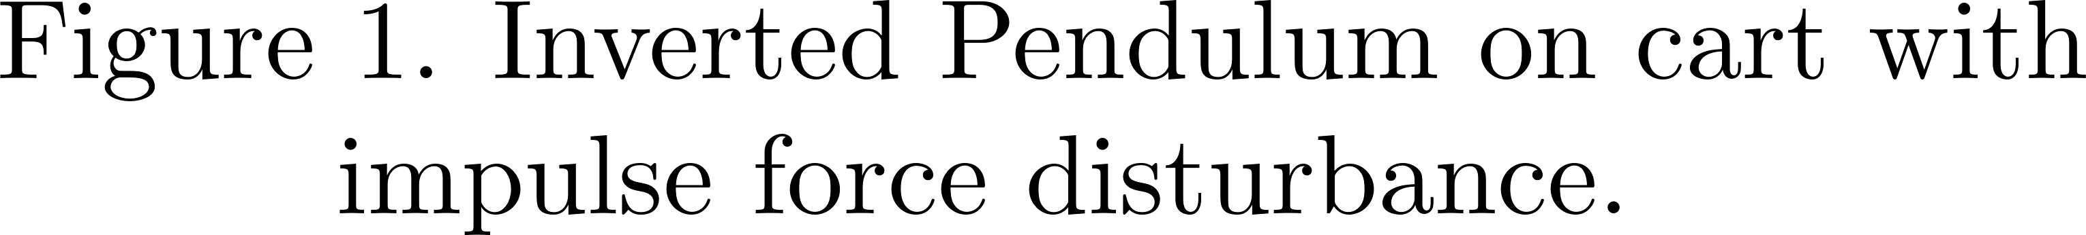

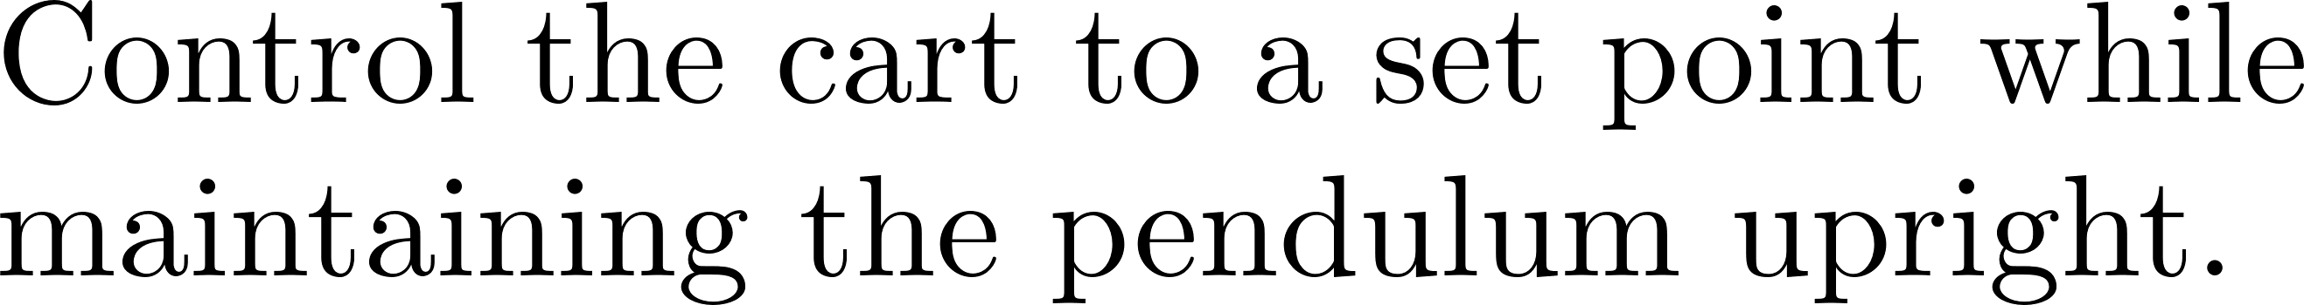
1. System Modeling – System Description
Ogata, Katsuhiko. Discrete-time control systems. Prentice-Hall, Inc., 1995.

Slide 4
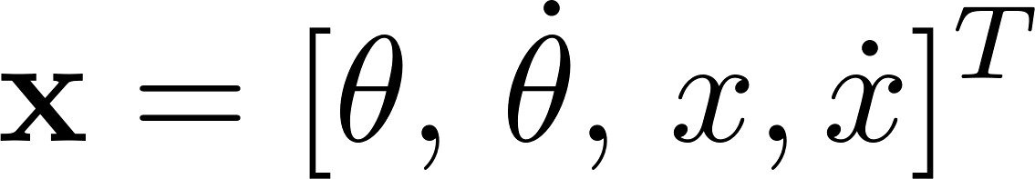
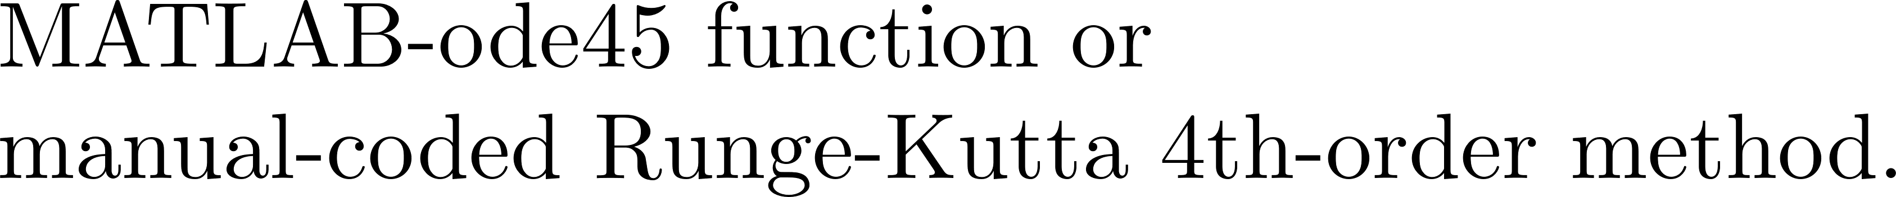
1. System Modeling – Nonlinear Dynamics
Appendix A, B describes the derivation of the nonlinear dynamics and RK4, respectively.

Slide 5
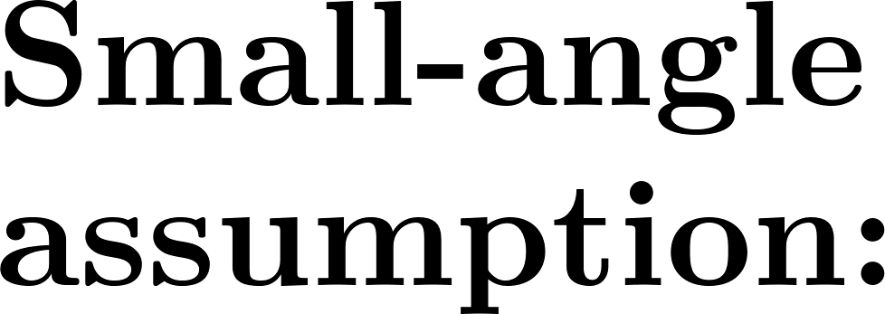
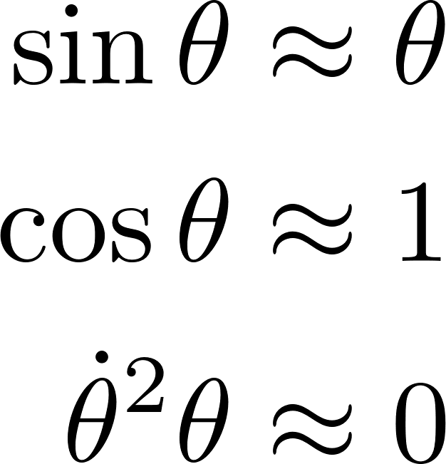
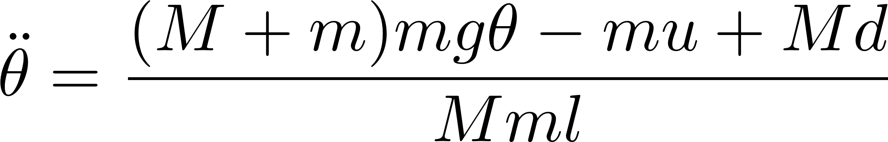
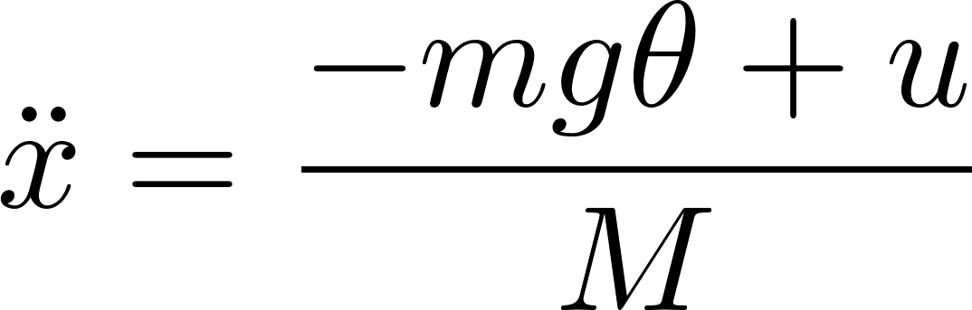

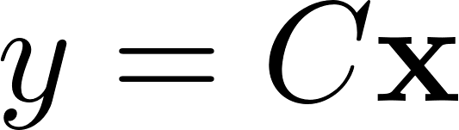
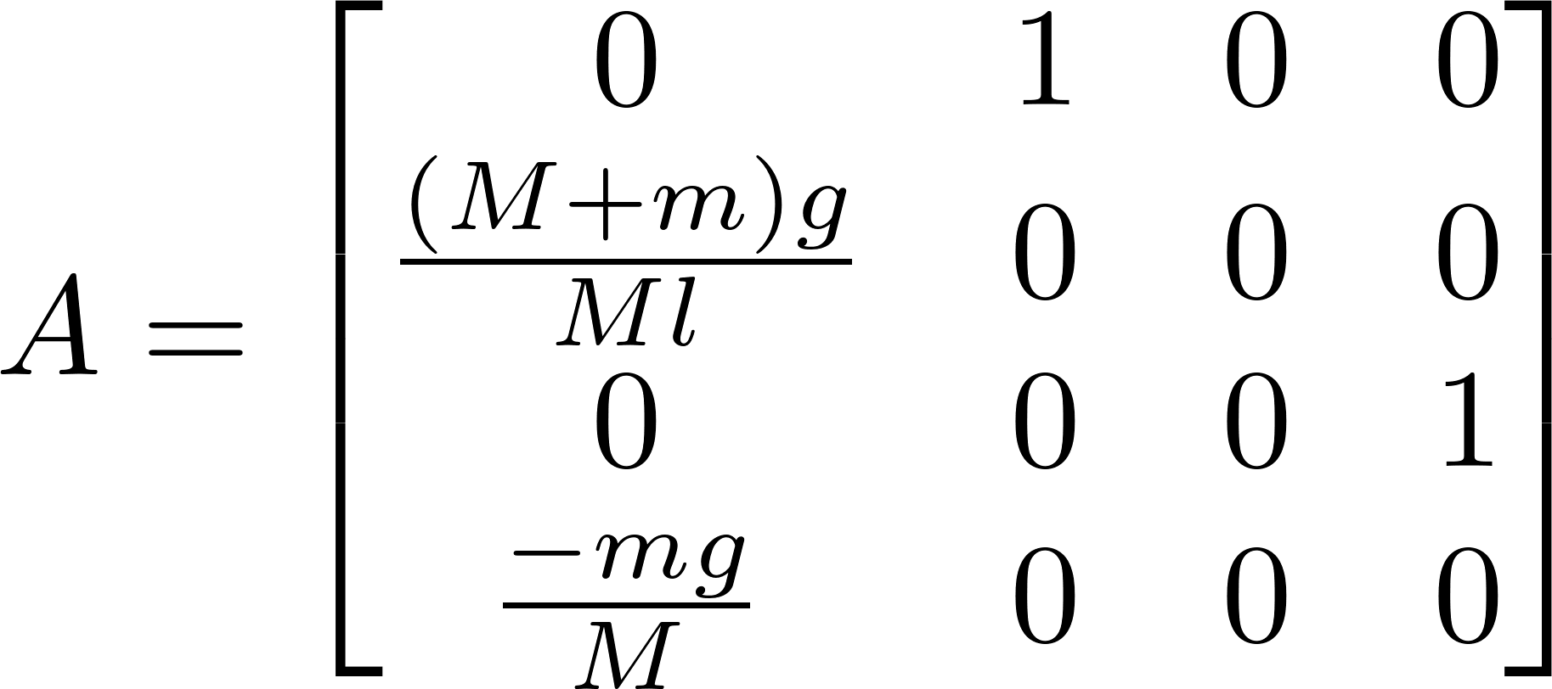
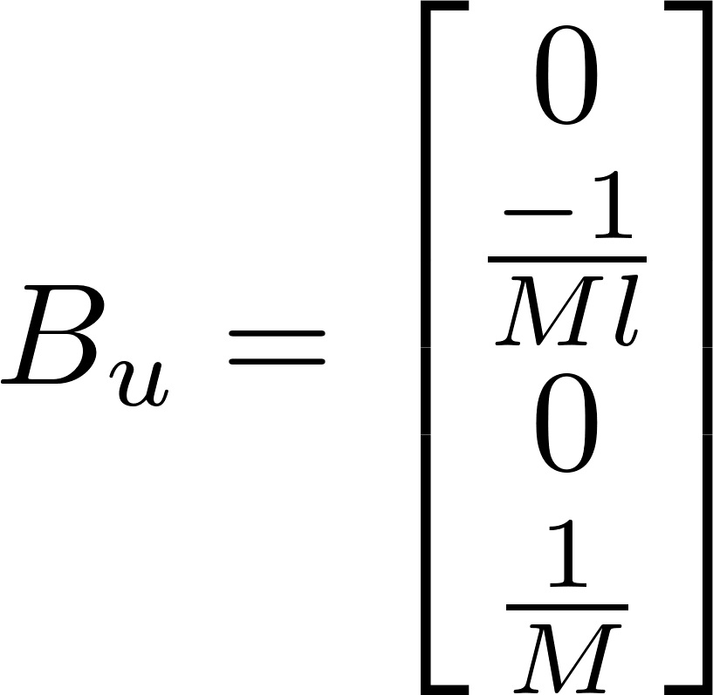
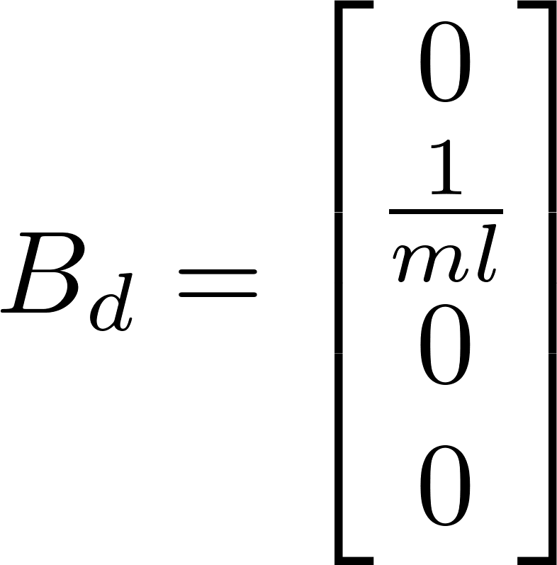
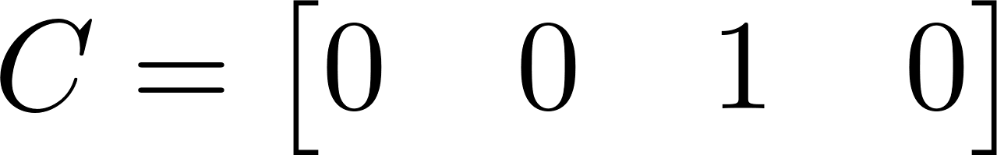
1. System Modeling – Linearization

Slide 6
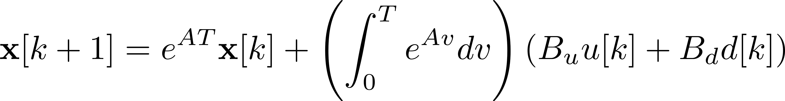
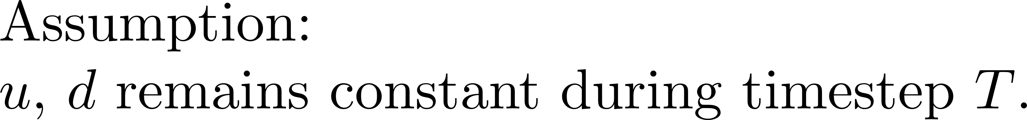
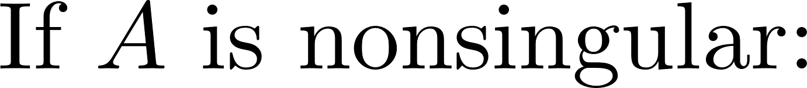
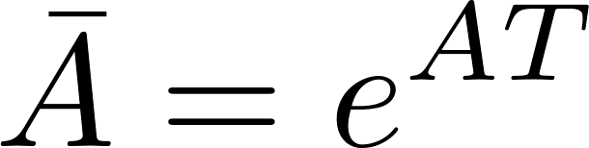
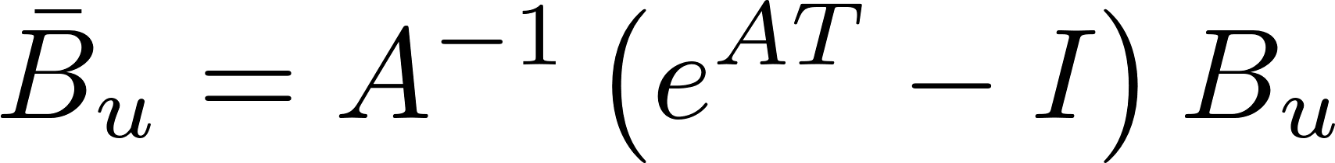
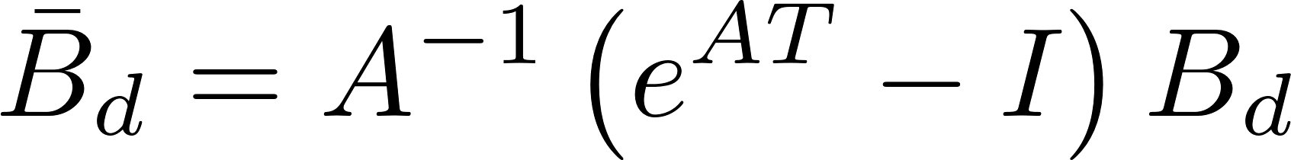
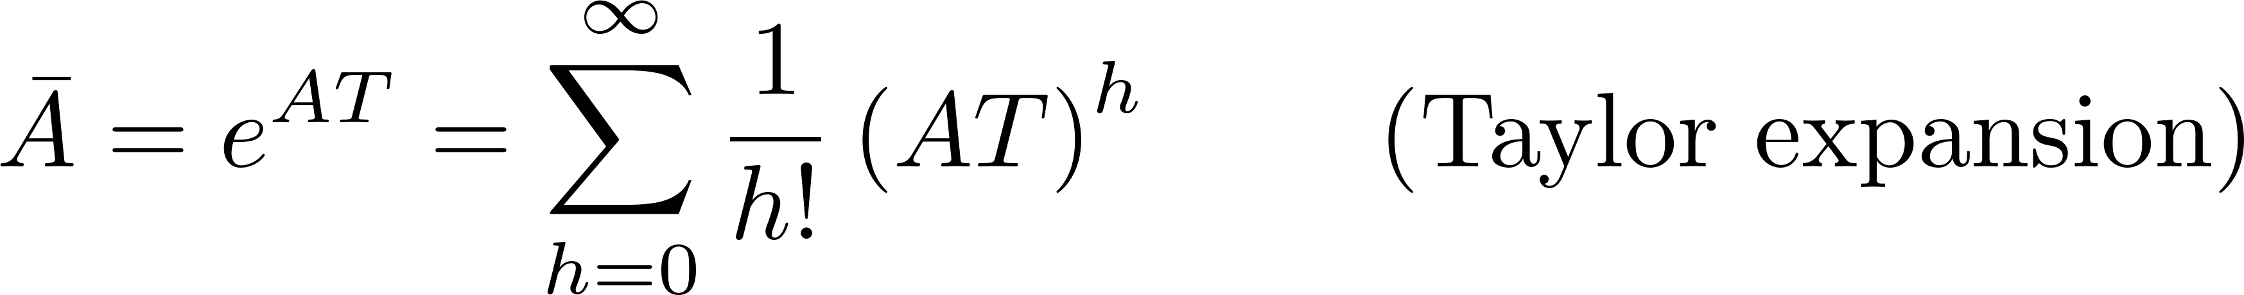
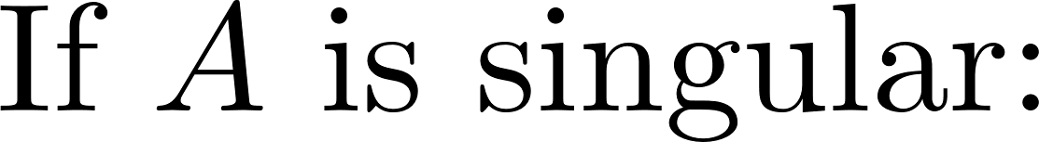
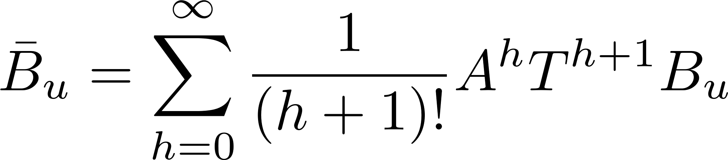
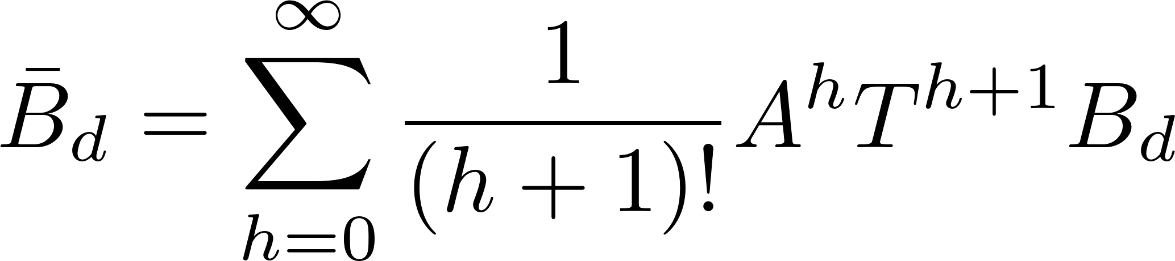

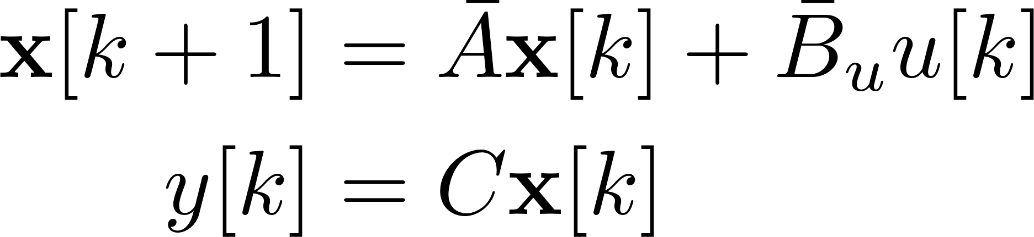
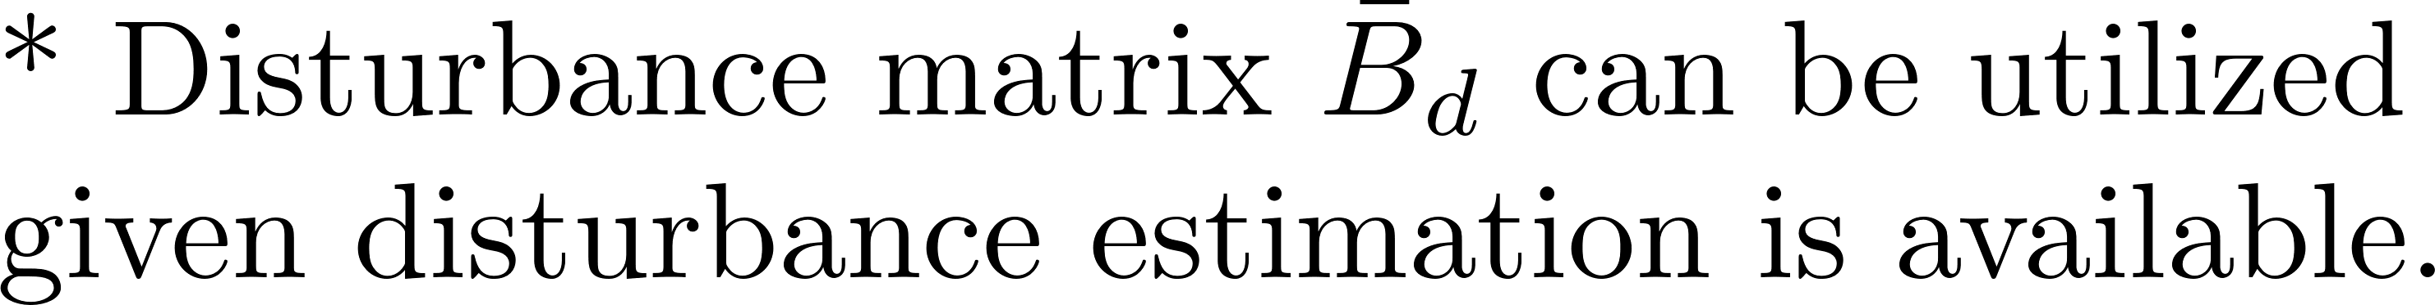
1. System Modeling – Discretization
Appendix C details the derivation of the discretization problem.

Slide 7

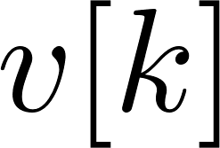
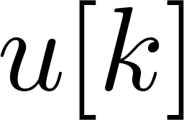
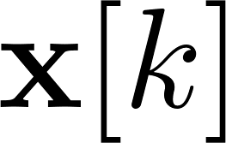


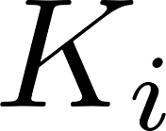
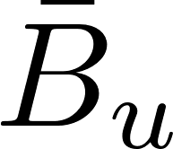

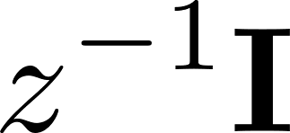

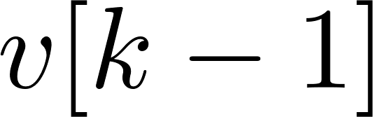
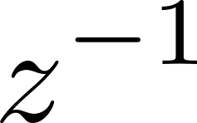

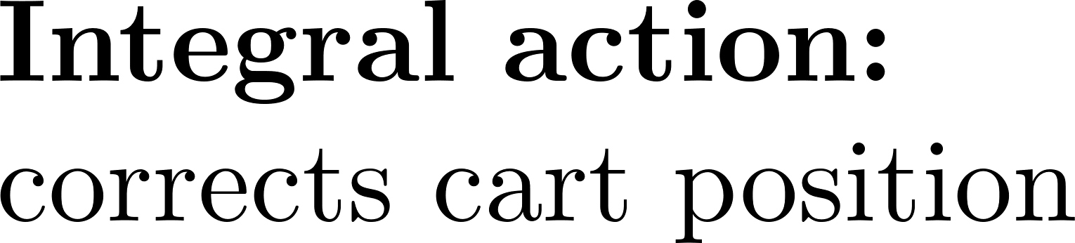
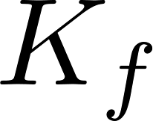


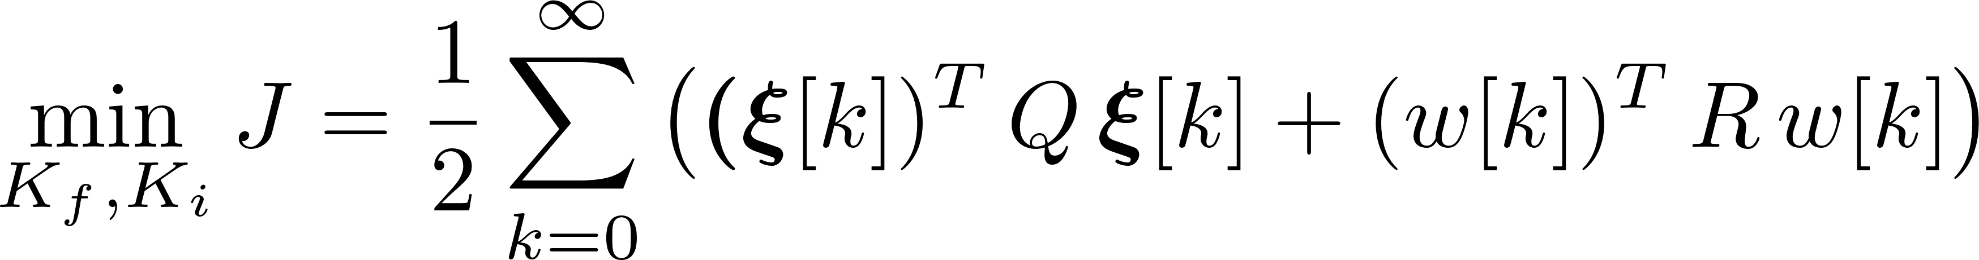
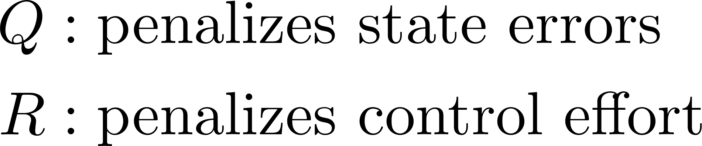
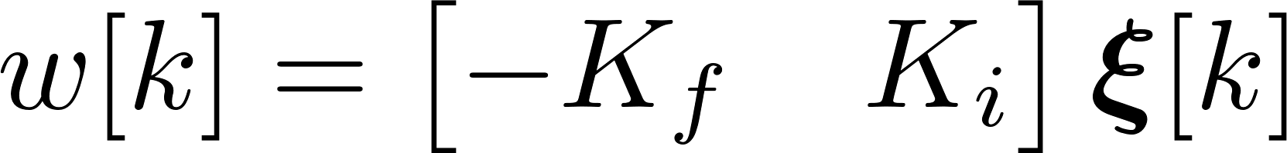

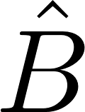
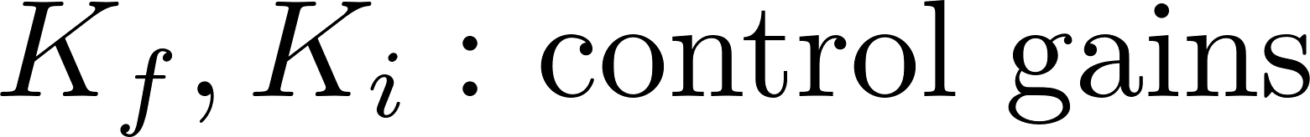
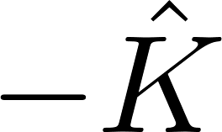
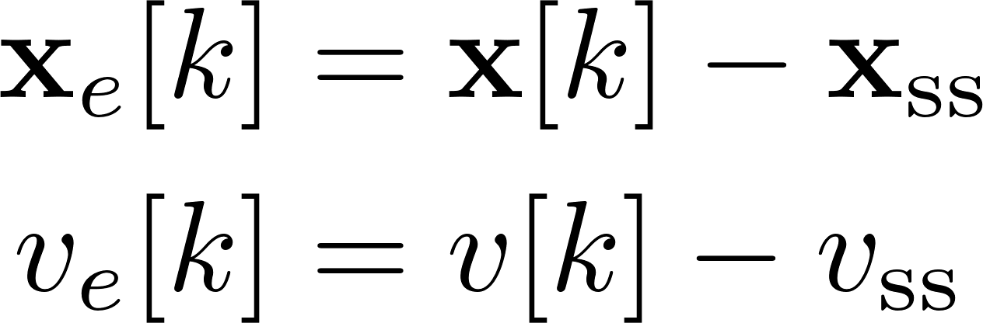
2. Control Design – LQR-i (integral) Formulation
Detailed derivation can be found in the textbook & Appendix D.

Slide 8
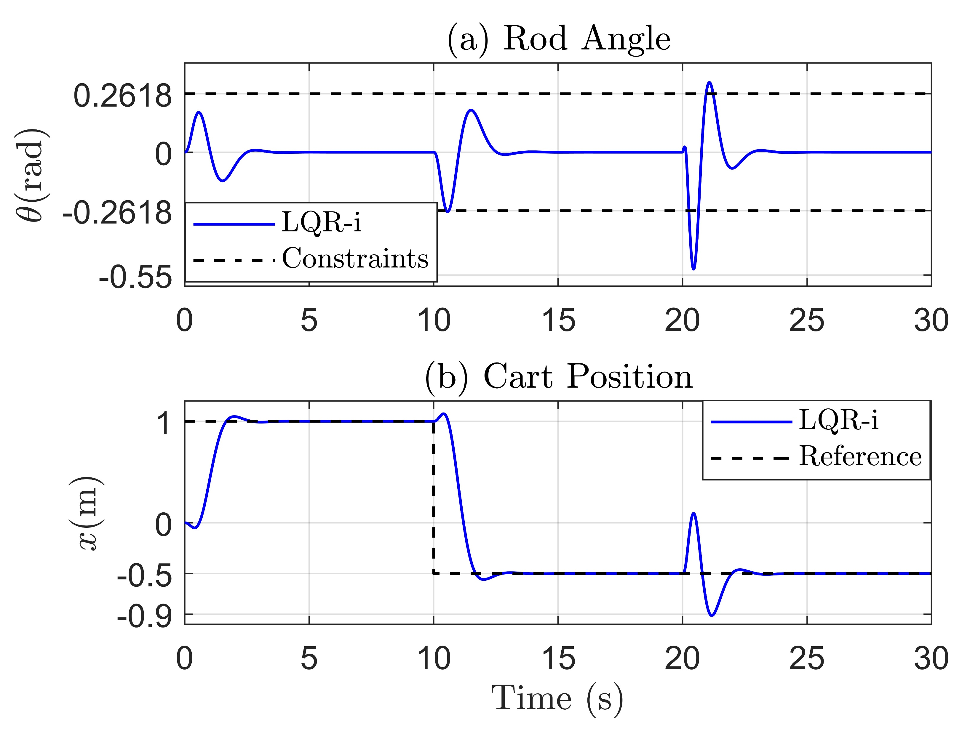
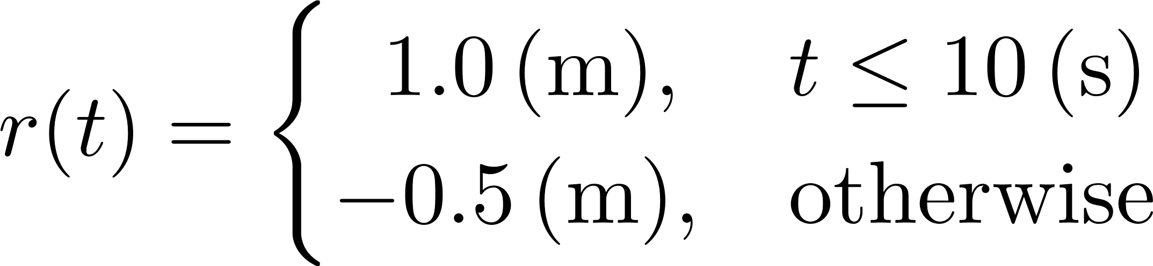

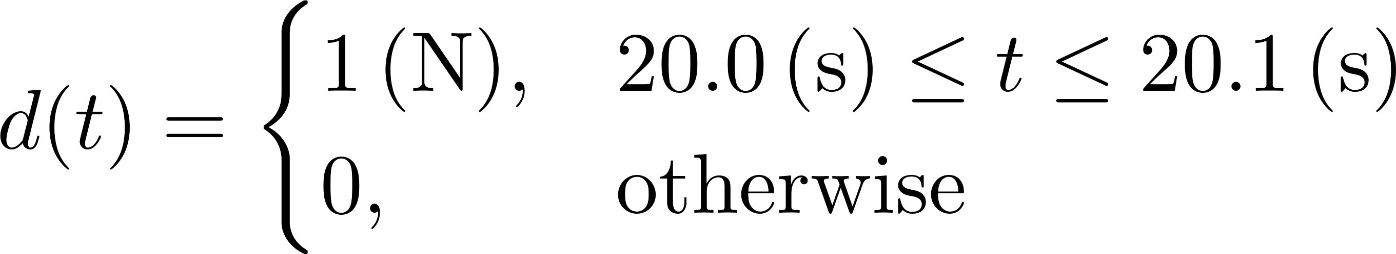

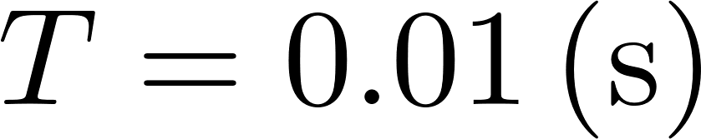
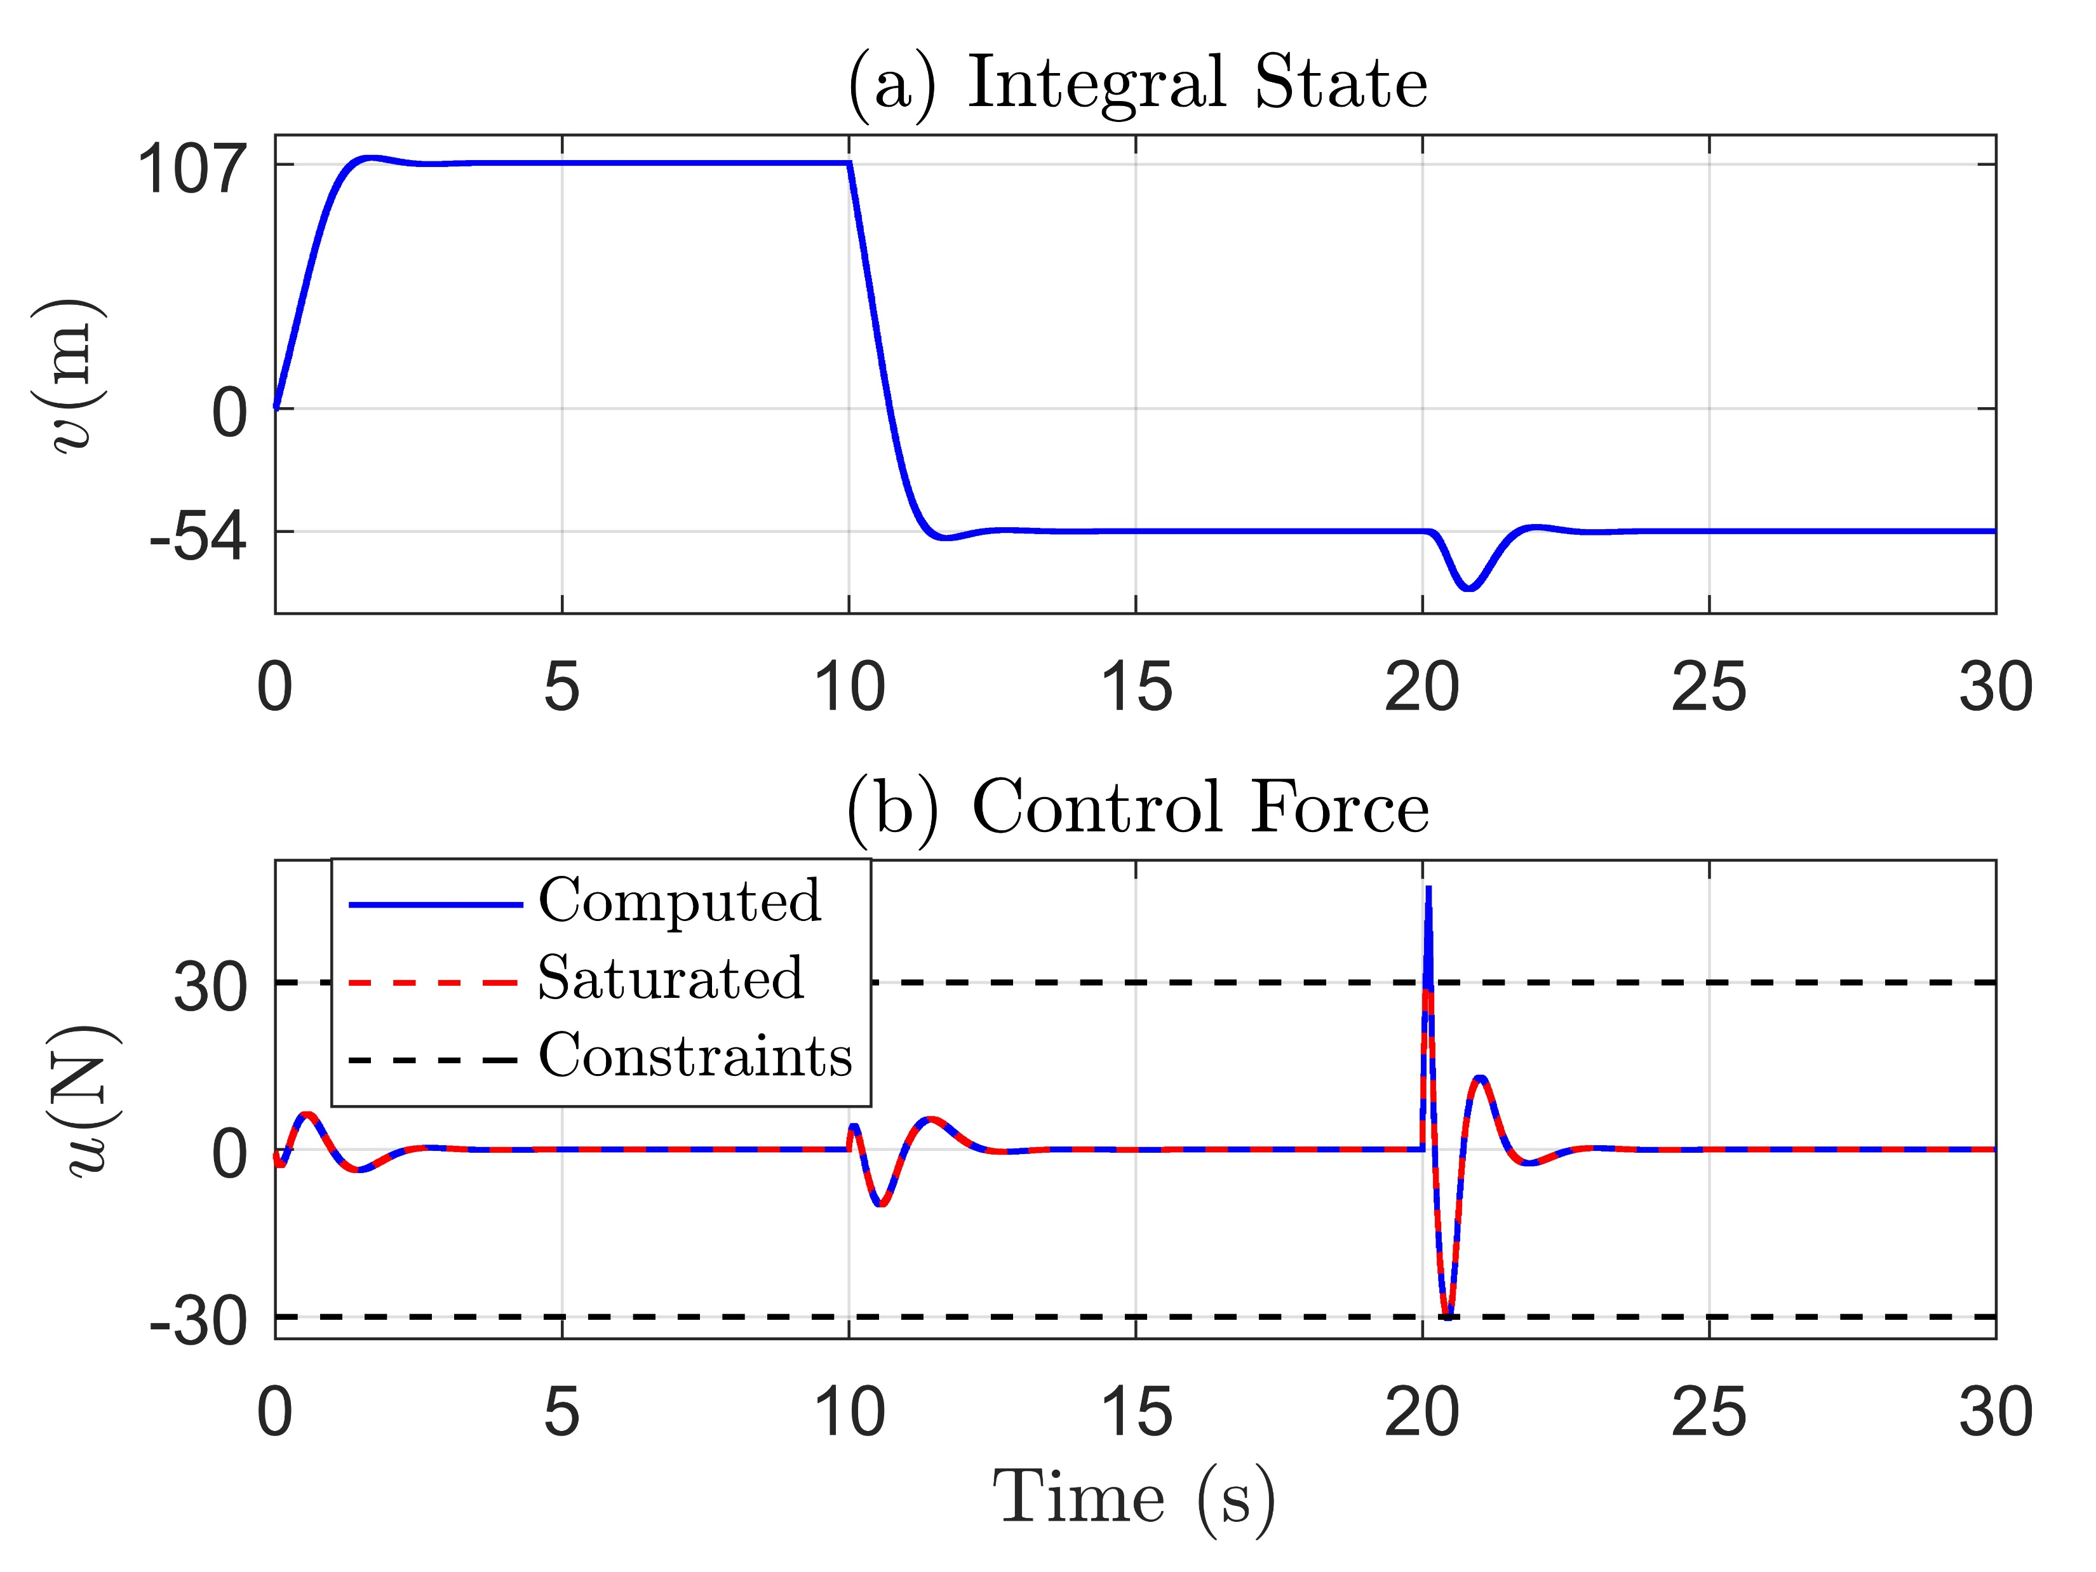


2. Control Design – LQR-i (integral) Result

Slide 9
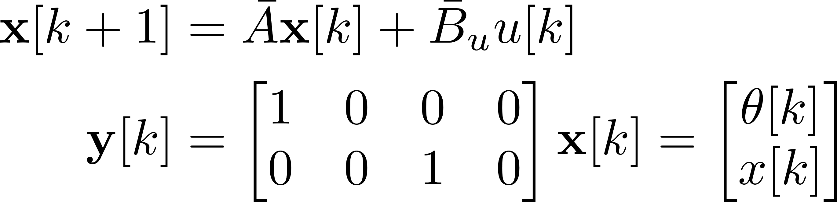














2. Control Design – LQR-v (velocity) Formulation

Slide 10




2. Control Design – LQR-v (velocity) Result

Slide 11




2. Control Design – LQMPC Formulation

Slide 12





2. Control Design – LQMPC Formulation (cont.)
Detailed QP reduction can be found in Appendix E.

Slide 13



2. Control Design – LQMPC Result

Slide 14
3. Conclusions

Slide 15



Appendix A – Nonlinear Dynamics

Slide 16






Appendix B – Runge-Kutta 4th-order Method

Slide 17







Appendix C – Discretization

Slide 18




Appendix C – Discretization (cont.)

Slide 19






Appendix D – LQR-i Formulation

Slide 20













Appendix E – QP Reduction

Slide 21










Appendix E – QP Reduction (cont.)

Slide 22






Appendix E – QP Reduction (cont.)

Slide 23
Appendix E – QP Reduction (cont.)

Slide 24






Appendix F – Velocity Form Discussion

